Slide 1
Initial Setup with Docker Lab-session 0
Computer Vision and Image Processing
Prof: Luigi di Stefano - luigi.distefano@unibo.it Tutors: Pierluigi Zama Ramirez - pierluigi.zama@unibo.it Riccardo Spezialetti – riccardo.spezialetti@unibo.it

Slide 2
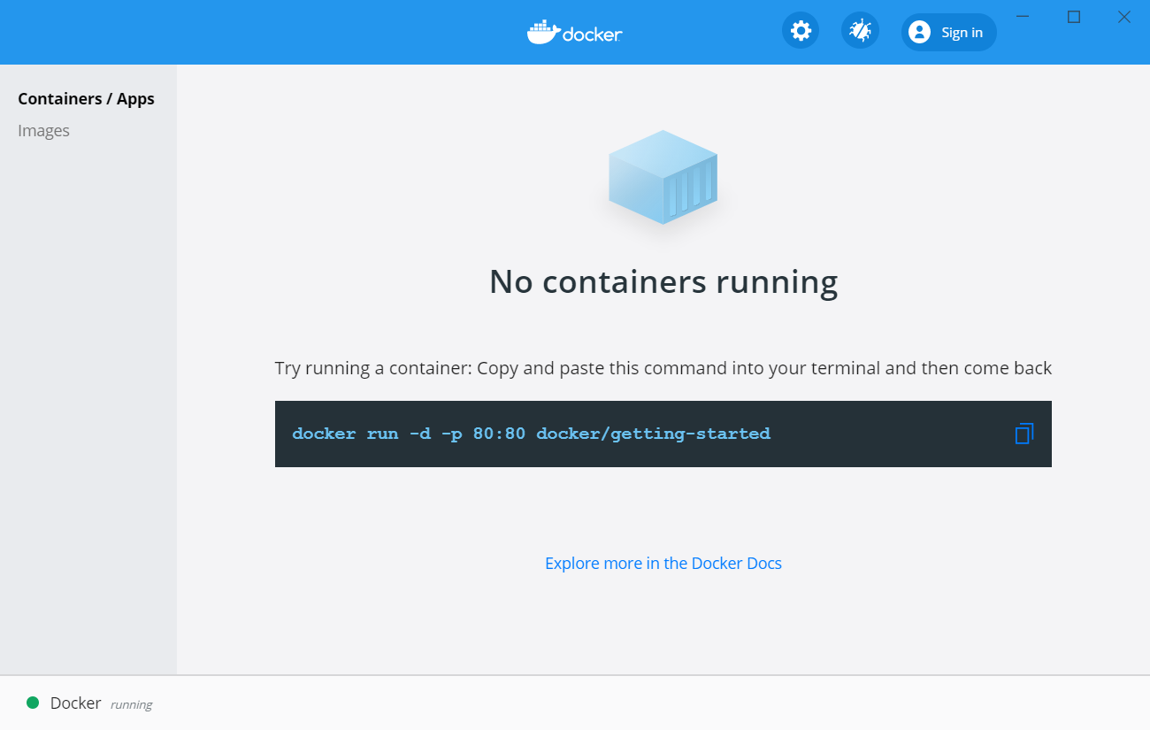
Step 1: Installing and running Docker
What is Docker? Docker is a tool designed to make it easier to create, deploy, and run applications by using containers.
More details at: https://www.docker.com/
Install and Run Docker on Windows
Install Docker on Ubuntu
Follow the instruction at the following link: https://docs.docker.com/docker-for-windows/install/
Run the Docker Desktop application
Follow the instruction at the following link. Installation from repository is recommended. https://docs.docker.com/engine/install/ubuntu/

Slide 3
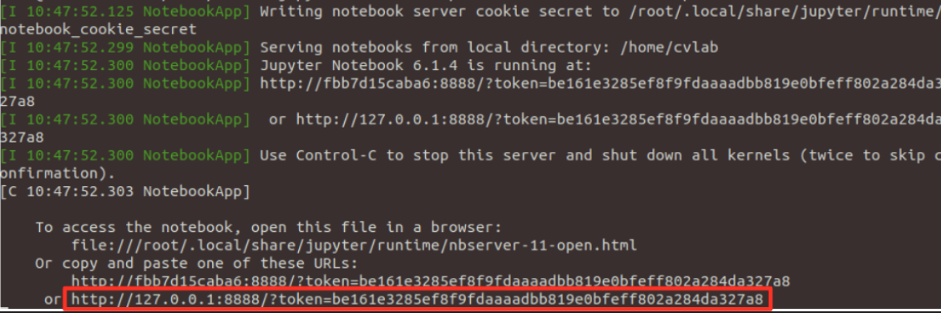
Step 2: Build and Run Docker Container
Download the Dockerfile configuration file
Open a terminal and navigate to the directory containing the configuration file
Execute the following command to build the docker container:
Download the Lab Session .zip file and unzip it. Remember the path to the unzipped folder path:
Execute the following command to run docker container
Click or copy link highlighted in the following picture to open the notebook:
docker build . -t cvlab
In Ubuntu:
For instance PATH_TO_EXERCISES=“/home/pippo/Downloads/LabSession1”
In Windows:
For instance $PATH_TO_EXERCISES=“C:\Users\pippo\Downloads\LabSession1”
PATH_TO_EXERCISES=“/path/to/exercise”
$PATH_TO_EXERCISES=“/path/to/exercise”
docker run -v ${PATH_TO_EXERCISES}:/home/cvlab -p 8888:8888 cvlab:latest

Slide 4
Stop containers and delete images
If you want to stop all the running containers and delete the images (for instance to run again step 5), you can use the following command:
docker stop $(docker ps -aq)

Slide 5
[OPTIONAL] Connect your webcam to Docker Container (Only Ubuntu)
Docker cannot recognize devices outside from the container. We must explicitly show the device when running the container.
In Ubuntu is quite straightforward. At step 5 of the previous slide, when running the docker container, we run the following command instead:
In Windows we recommend the following guide:
https://docs.microsoft.com/en-us/virtualization/windowscontainers/deploy-containers/hardware-devices-in-containers
docker run -v ${PATH_TO_EXERCISES}:/home/cvlab -p 8888:8888 --device=/dev/video0:/dev/video0 -it cvlab:latest

